Slide 1




Uniting for Progress: ffioving Beyond Tribal Politics for a Stronger Kenya C025-01-1869/2020 GATHIMA STEPHEN MBURU

Slide 2


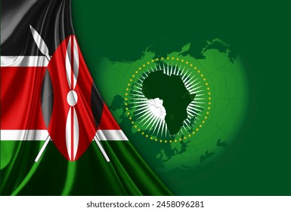

Introduction to Unity
Uniting for Progress is essential for Kenya's future. This comprehensive presentation delves into the significance of transcending tribal politics to cultivate a more robust and unified nation. Tribal politics, with its divisive nature, has often been a source of conflict and stagnation, hindering the nation's potential for growth and development. By embracing the rich diversity that characterizes Kenya, we can harness the strengths and perspectives of various communities to build a cohesive society. This presentation emphasizes the importance of collaboration among different ethnic groups, advocating for a collective approach to national issues. Such collaboration is pivotal in addressing common challenges and seizing opportunities for mutual benefit.

Slide 3

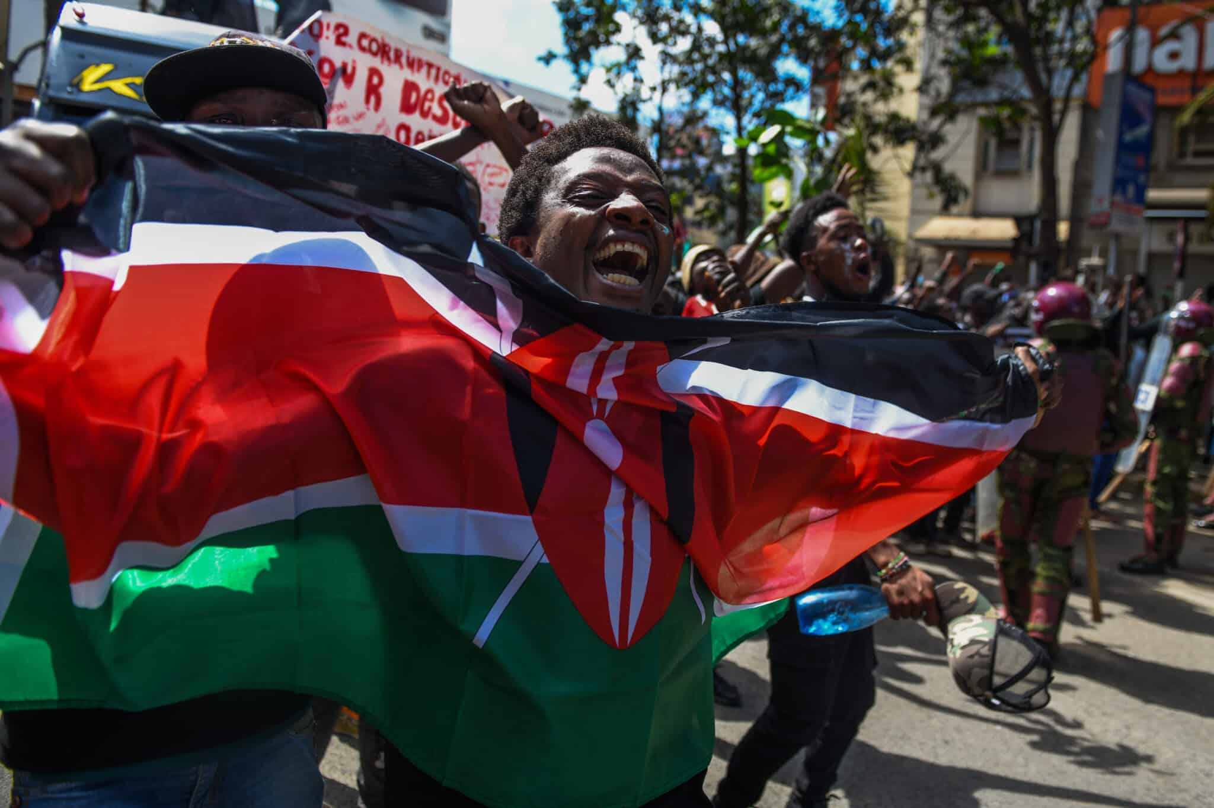

Understanding Tribal Politics
Uniting for Progress is essential for Kenya's future. This comprehensive presentation delves into the significance of transcending tribal politics to cultivate a more robust and unified nation. Tribal politics in Kenya often leads to division and conflict, hindering the nation's potential for growth and development. It is crucial to understand how these political affiliations impact governance and national cohesion. By recognizing the challenges posed by tribalism, we can work towards a more inclusive political landscape that benefits everyone. Embracing the rich diversity that characterizes Kenya allows us to harness the strengths and perspectives of various communities to build a cohesive society. This presentation emphasizes the importance of collaboration among different ethnic groups, advocating for a collective approach to national issues. Such collaboration is pivotal in addressing common challenges and seizing opportunities for mutual benefit.

Slide 4



The Importance of Unity
Unity is vital for national progress. When Kenyans come together, they can effectively address pressing issues such as poverty, corruption, and education. A united Kenya can leverage its rich cultural diversity to foster innovation and economic growth, paving the way for a brighter future. By working collaboratively, the nation can overcome challenges and unlock new opportunities for development. This collective effort is essential for building a prosperous and stable Kenya that benefits all its citizens.

Slide 5

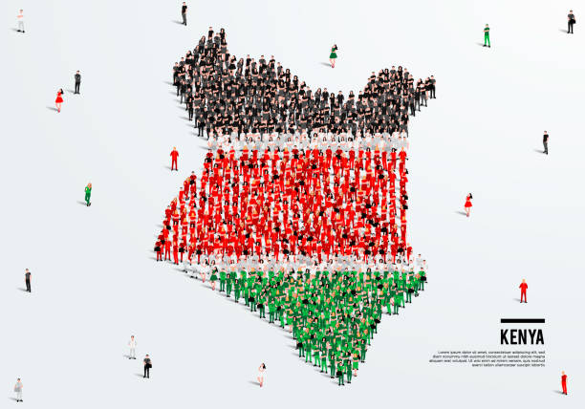
Strategies for Collaboration
To move beyond tribal politics, we must implement strategies that promote collaboration. This involves encouraging dialogue, fostering inclusive governance, and creating platforms for cross-cultural exchanges. By prioritizing these strategies, we can build a more harmonious society where every voice is heard. These efforts will help to create a more inclusive and united nation, paving the way for sustained development and stability.

Slide 6
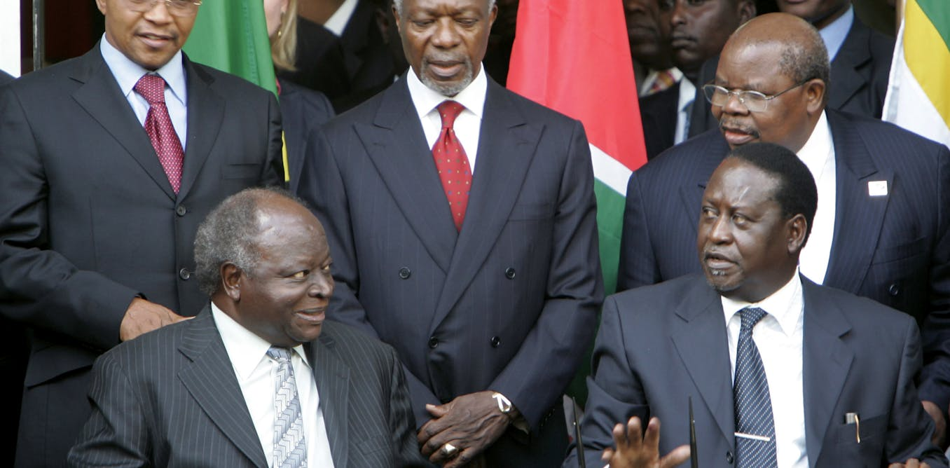
Success Stories
Kenya is replete with numerous success stories where communities have united for a common cause, showcasing the incredible power of collective effort in overcoming significant challenges. These examples illustrate how unity can address pressing issues, from improving local infrastructure to advancing education and healthcare. By highlighting such stories, we not only celebrate the achievements of these communities but also inspire others to follow suit. These success stories serve as powerful reminders of what can be accomplished when people set aside their differences and work together towards shared goals. Embracing a spirit of collaboration, we can pave the way for a brighter, more prosperous future for all Kenyans, fostering an environment where every community thrives.

Slide 7


Conclusion: A Uni ied Future
Necessity of Unity for Progress:
Uniting for progress is not merely an ideal but a critical requirement for
Kenya's growth and development.
Moving Beyond Tribal Politics:
Transitioning from tribal politics is essential to foster national unity.
This shift will help create a stronger, more resilient nation.
Commitment to the Future:
Commitment to unity, collaboration, and progress should be at the
forefront of Kenya's national agenda.
Prioritizing these values ensures sustainable development and stability.

Slide 8
Conclusion: A Uni ied Future
Call to Action:
Let us dedicate ourselves to building a future where these principles guide
our collective efforts.
Embrace strategies that promote inclusive governance, cross-cultural
dialogue, and community collaboration.
Vision for a United Kenya:
By focusing on unity and collaboration, we can overcome challenges and
unlock the nation's potential.
A united Kenya will be better positioned to achieve long-term prosperity
and improved quality of life for all its citizens.

Slide 9


Thanks!

